Slide 1
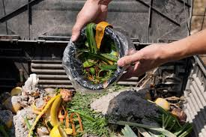
Leftover Food Redistribution Network
By: CODE WARRIORS (Harsh Garg, Milan Kuiry)

Slide 2
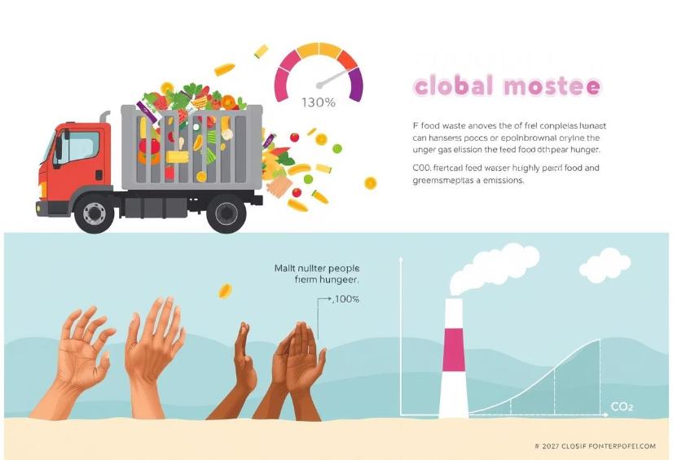
The Problem: Food Waste vs. Hunger
India's Food Waste
Over 67 million tons wasted annually.
Hunger in India
Over 190 million face food insecurity.
Environmental Impact
8% of global greenhouse gas emissions.

Slide 3






The Solution: Connecting Surplus Food
Donors
Volunteers
Receiver
Redistribute leftover food
to those in need.
Restaurants,
homes,
Hostels , Banquet hall

Slide 4
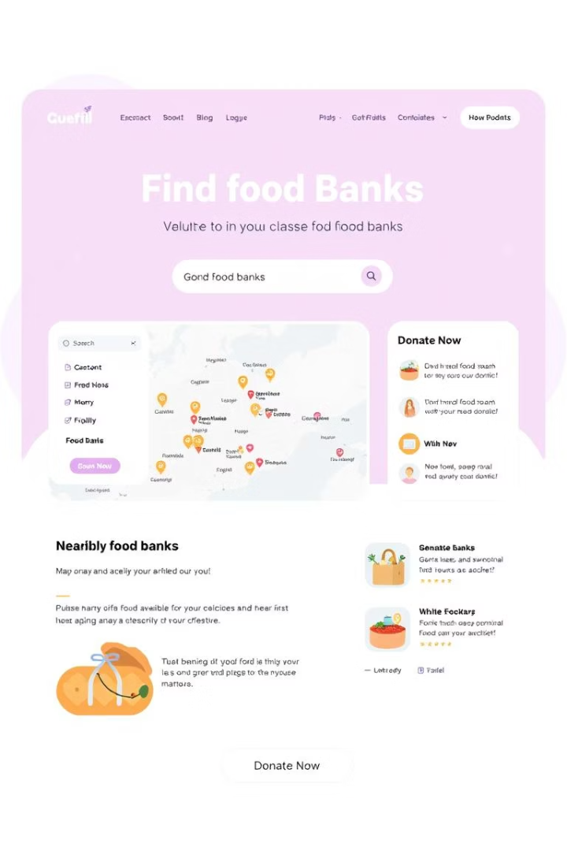
Core Features and Functionalities
Donor Section
NGO Section
Register, schedule pickups, track.
Sign up, manage collections, alerts.
Volunteer Section
Track routes, task notifications.

Slide 5
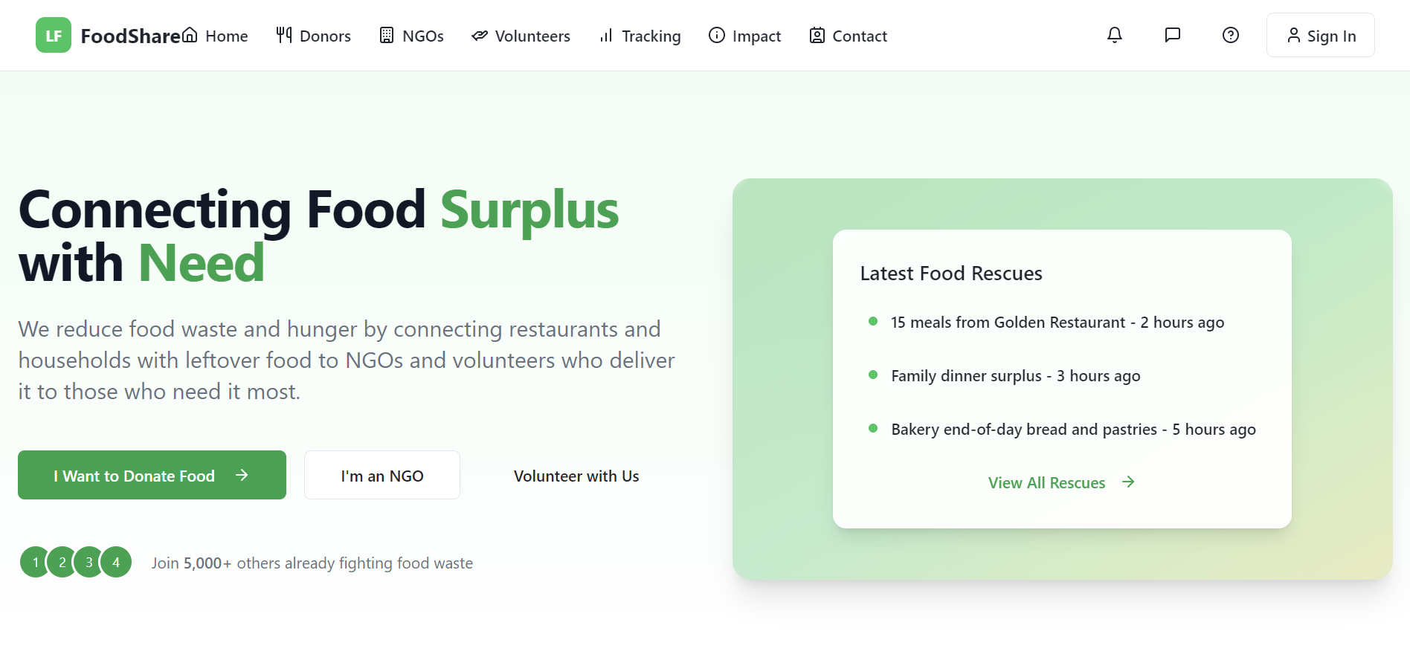
Tech Stack & Key Implementations
Frontend
Maps API
HTML, CSS, JavaScript
Real-time tracking
1
2
3
Backend
Firebase: Auth, DB, Notifications

Slide 6
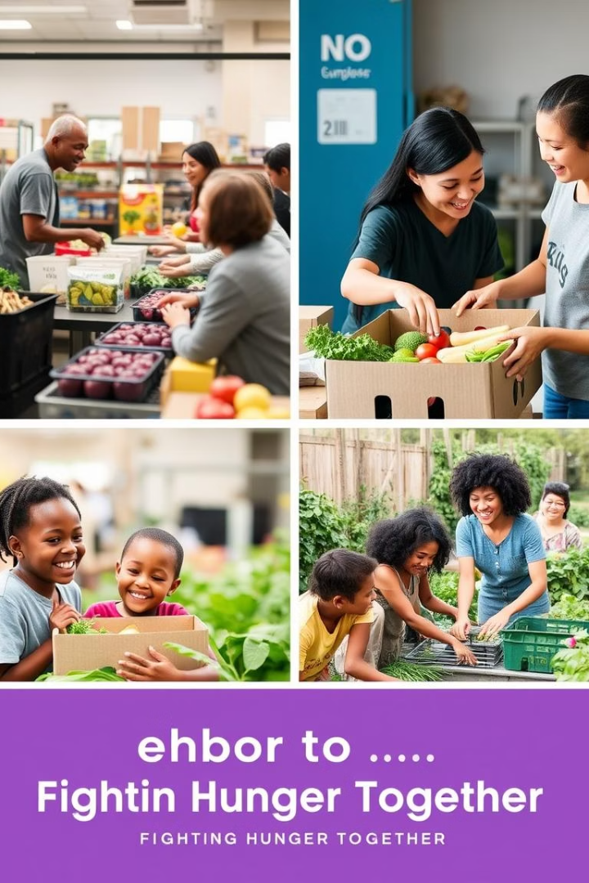



Social Impact and Reach
Immediate Impact
Long-Term Impact
Food for millions,
waste reduction
Circular economy, environmental benefits
Scale
Expand across India and globally

Slide 7
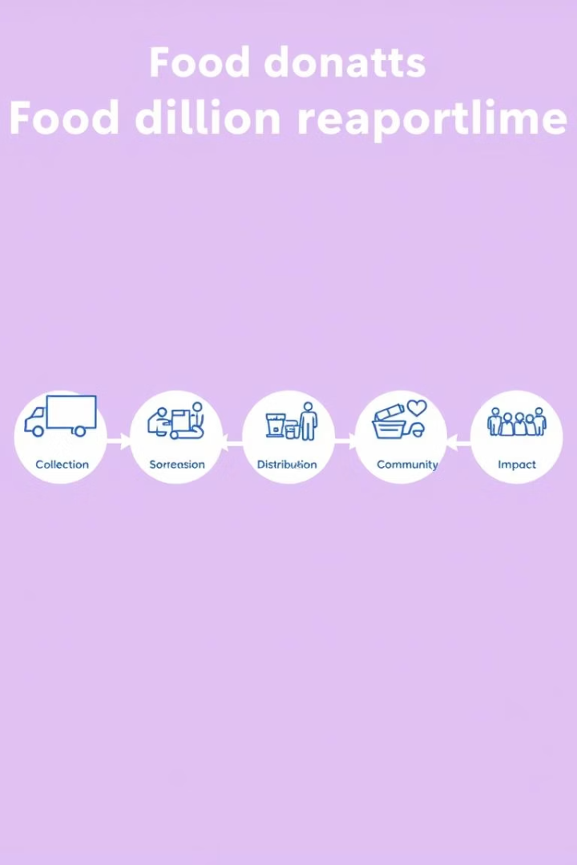
Next Steps & Scalability
Phase 1:
Launch in one city and gather feedback.
Phase 2:
Expand to more cities and add NGOs.
Phase 3:
Launch a mobile app for wider reach.
Long-Term:
Partner with food banks to scale further.

Slide 8




Get Involved and Help Us Scale
Developers
Volunteers
Organizations
Funding, mentorship, partnerships needed.

